Slide 1
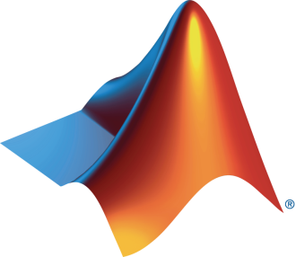
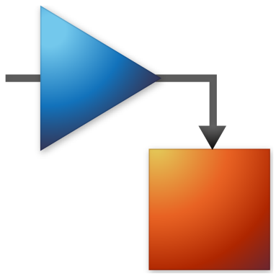
University and MathWorks Present: App Building Onramp

Slide 2
Today:
6:15 pm – 6.30 pm: Set-up
Intro to App Building Onramp
Create MathWorks account
Log in to App Building Onramp / Test MATLAB Online
6.30 pm – 8.00 pm: App Building Onramp (on your own)
Problem statement release for App Building Challenge
Submission date:

Slide 3
What is a MATLAB App?
User Interface tool
Interact with code and data visually
Custom apps with buttons, sliders, plots etc.
Simplify complex workflows
Run MATLAB code without directly interacting with the command line
Notes:
A MATLAB App is a user interface (UI) tool built in MATLAB that allows users to interact with their code and data visually. It provides a way to create custom apps with buttons, sliders, plots, and other interactive elements to perform specific tasks or analyses. MATLAB Apps are designed to simplify complex workflows, making it easier for users to run their MATLAB code and algorithms without needing to directly interact with the command line.

Slide 4
Why make an App?
Entrepreneurial Experience & Industry Relevance
Technology Fluency & Problem-based Learning
Person Growth & Global Reach
Notes:
Why make an App?
Entrepreneurial Experience: Building an app provides students with the opportunity to learn about product development, market research, and potentially even entrepreneurship, fostering a spirit of initiative and business acumen.
Industry Relevance: In today's tech-driven world, app development skills are highly sought after by employers across various industries, making it a valuable addition to a student's skill set.
Community Impact: An app can be a platform for addressing societal challenges, allowing students to contribute meaningfully to their communities or causes they care about.
Technology Fluency: Developing an app enhances students' fluency with modern technologies, preparing them for the rapidly evolving digital landscape and potential future career opportunities in tech-related fields.
Problem-Based Learning: App development provides a real-world context for students to tackle complex problems, fostering a deeper understanding of how to apply their knowledge to address practical challenges.
Personal Growth: The process of app development can significantly enhance students' perseverance, adaptability, and resilience, as they navigate the complexities of creating and refining a functional product.
Global Reach: Apps have the potential to reach a global audience, allowing students to gain exposure and recognition on an international scale, thereby expanding their professional network and opportunities.
These reasons collectively highlight the multifaceted benefits of app development for students, encompassing technical skills, personal growth, and potential career opportunities.

Slide 5

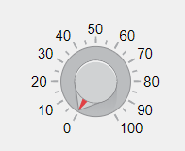
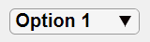

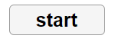
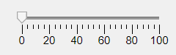
Create → Package → Share
?
Notes:
So, how would you go about creating an app yourself? Here is the process of producing a shareable app. First you create your app, package it, and then share it. When you first create an app, you may be confused where to place all of your components. I suggest thinking about it first and try sketching out your User Interface before beginning.

Slide 6
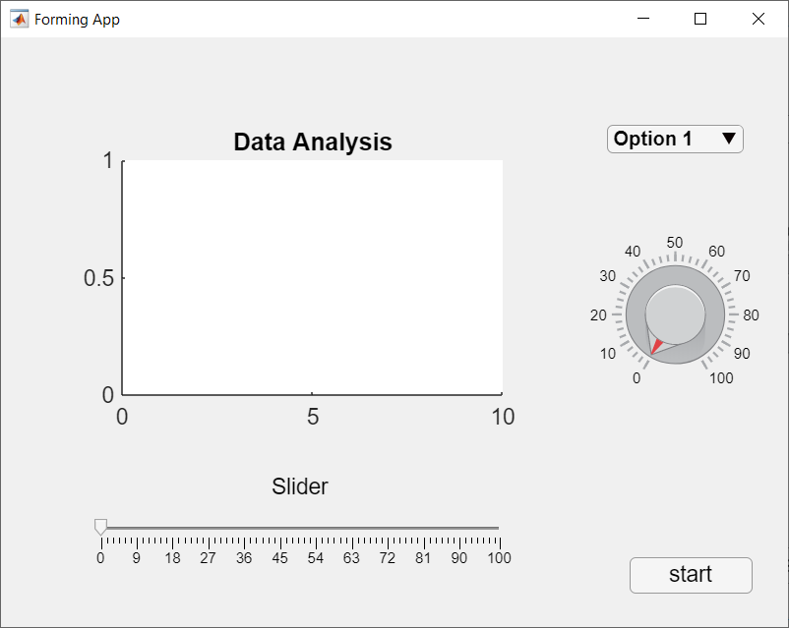

Create → Package → Share
☺
Notes:
Once you have a clear design of your user interface, then you can create it with App Designer.

Slide 7
Create → Package → Share
Notes:
Once your app is created, it is time to package your app for distribution.

Slide 8
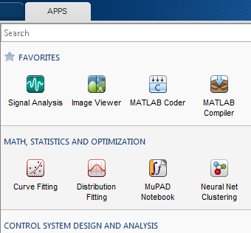
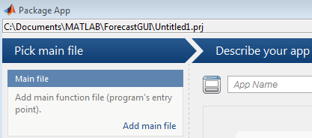
App Packaging
Package your app as a single installation file
Easy distribution and installation into the apps gallery
Automatically includes all necessary files
Documents required products
Notes:
When you package an app, MATLAB creates a single app installation file that enables you and others to install your app and access it from the apps gallery without concern for installation details or the MATLAB path.

Slide 9

Create → Package → Share
?
Notes:
Once you package your app, you are ready to share.

Slide 10
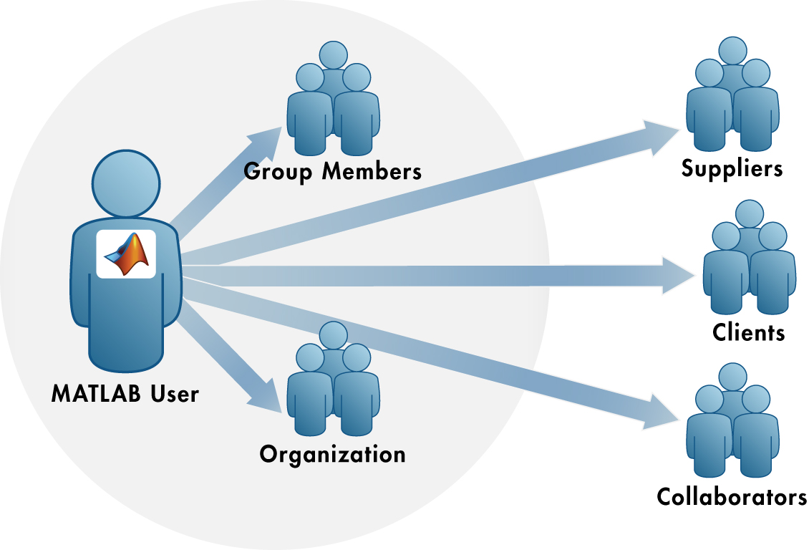

MATLAB Programs Can be Shared With Anyone
Share With Other MATLAB Users
Share With People Who do Not Have MATLAB
Notes:
MATLAB programs can be shared with anyone.
<CLICK> You can share them with other MATLAB Users
<CLICK> Or you can share them with people who do not have MATLAB

Slide 11
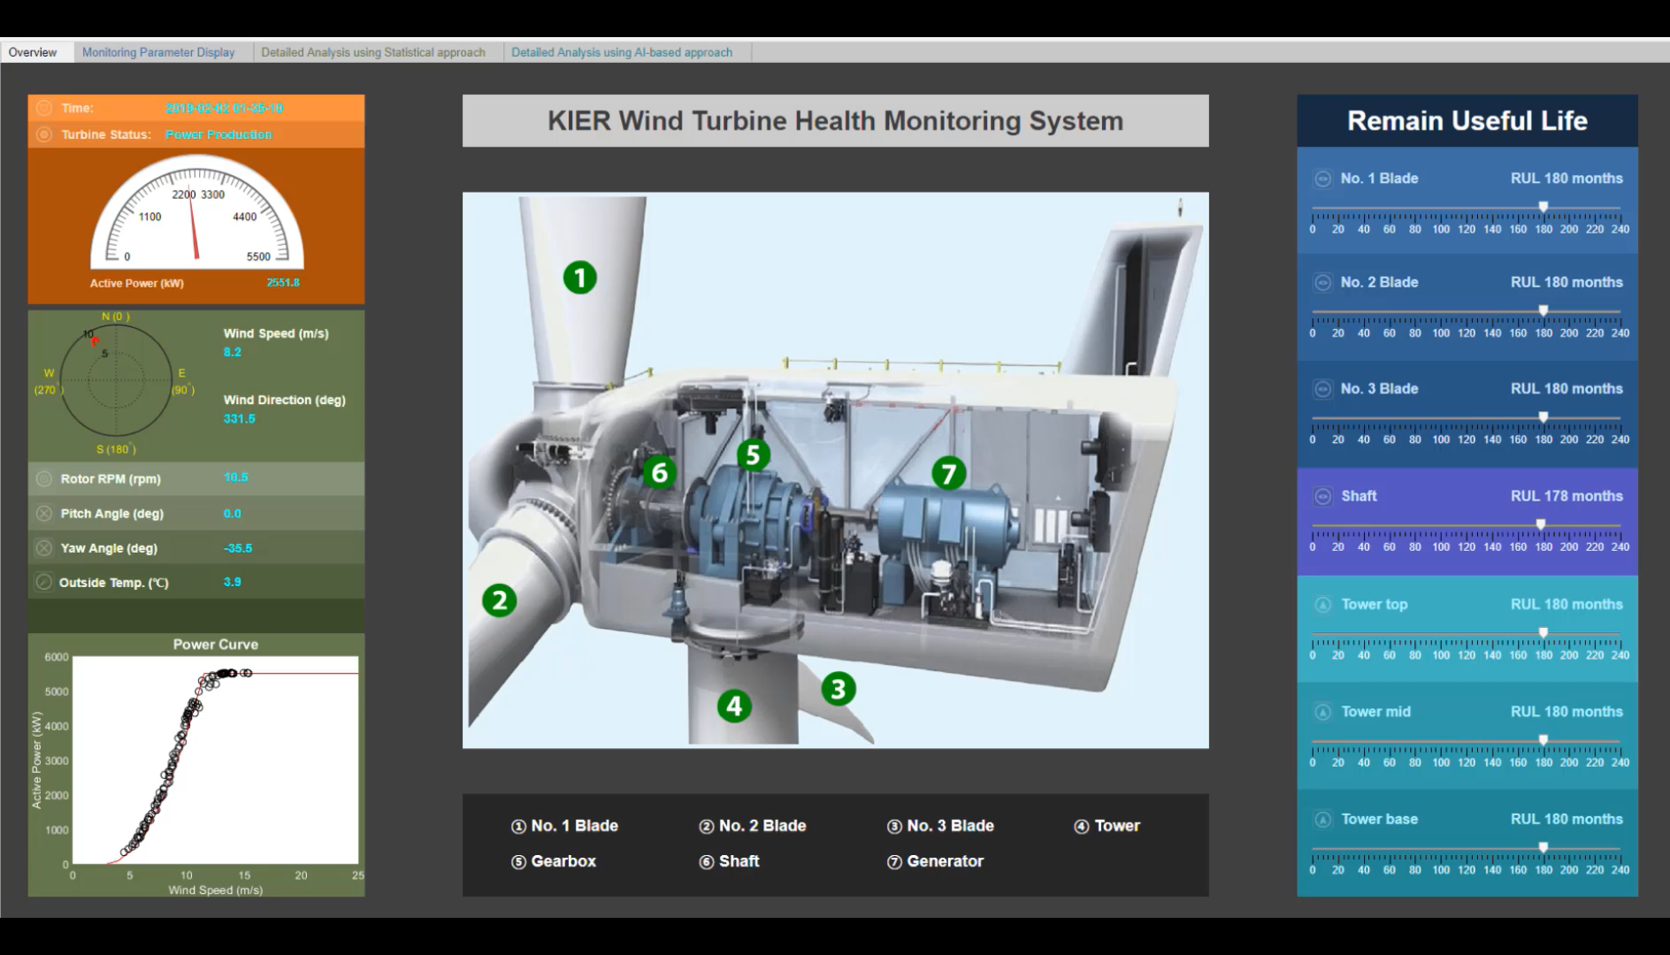
Notes:
Here is an app created with MATLAB’s App Designer by the Korea Institute of Energy Research. The Wind Turbine Health Monitoring System is used for predictive maintenance. By using our tools, they were able to cut their development time in half and achieve a 90+% prediction accuracy. The first of the 4 tabs shown at the top gives an overview of the wind turbine's status. <Click> The predicted remaining useful life of each component is shown on the right, where each component is labelled on the diagram in the center.
On the second tab of the app, you can see the time series data of different parameters for the blades, tower, gearbox, shaft, and generator in real time
41 seconds
On the third tab, Data analysis is shown using a statistical approach. Our signal processing toolbox was used to perform Fast-Fourier-Transforms for frequency analysis.
1:14
Finally, they performed data analysis using an AI-based approach with our Machine Learning and Deep Learning Toolboxes. Here, they calculated the damage equivalent load, represented by blue dots. If the blue dots are above the red triangles, representing the limits, an alarm will notify to user. A similar approach is used for the Remaining Useful Lifetime, where the blue dots approaching the red line means the remaining lifetime is short. This alarm system was able to save the institute millions of dollars.

Slide 12
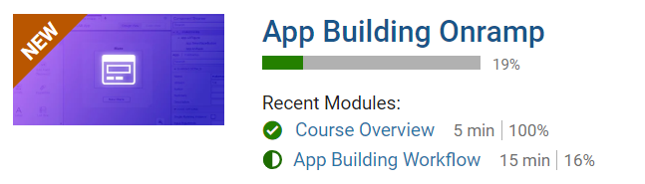
TO DO
Go to https://matlabacademy.mathworks.com/
Log in to your MathWorks account
Launch App Building Onramp

Slide 13
Prizes
Complete at least 50% of App Building Onramp to be eligible for any prize
Bring your laptop when you come to collect the prize
Follow Us on Facebook!
Find us on Facebook at [Insert Facebook Group Name]

